Slide 1


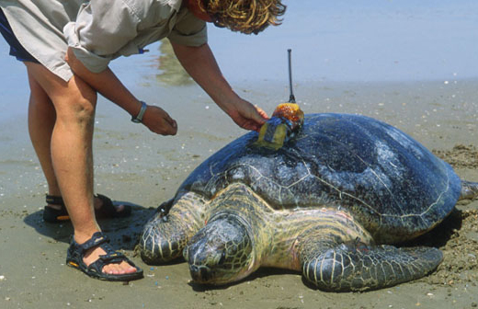
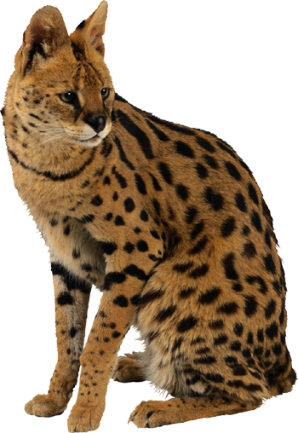
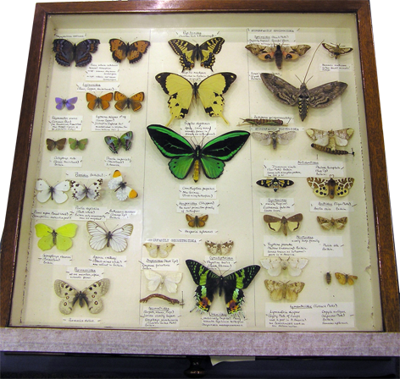

Ecology Series: Set 6
Copyright © 2005
Version: 1.0

Slide 2
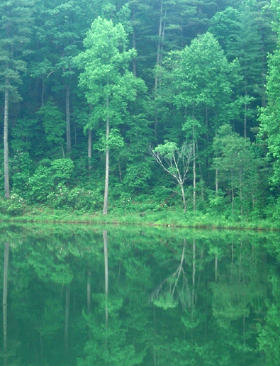
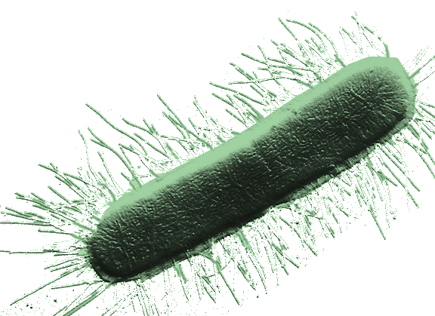
Biodiversity
Biodiversity describes all aspects of biological diversity, including species richness, ecosystem complexity, and genetic variation.
The species is the basic unit by which we measure biodiversity.
For some taxa, e.g. bacteria and protists, the true extent of species diversity remains largely unidentified. Bacteria are difficult to classify: they reproduce asexually and exchange genetic material readily, so new strains proliferate.
Rainforests are biologically diverse
E. coli bacterium

Slide 3
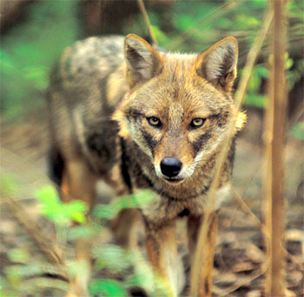
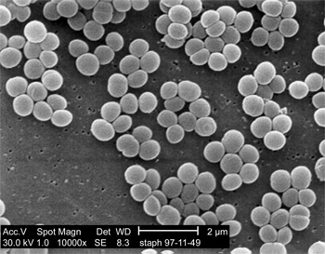
Species or Not?
Recognizing species diversity is made more problematic when so-called species do not fit our traditional definition:
“A species is a group of actually or potentially interbreeding natural populations that is reproductively isolated from other such groups”.
This definition is problematic for asexually reproducing organisms, including bacteria and protists, and long established hybrids, such as the red wolf.
The red wolf: is it a true species?
Antibiotic resistant S. aureus

Slide 4
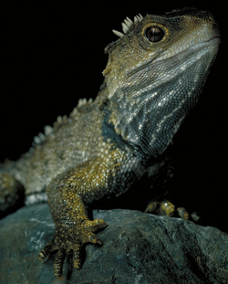
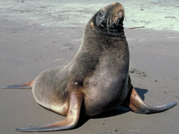
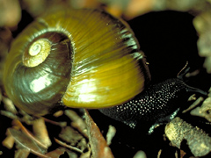
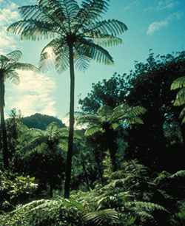
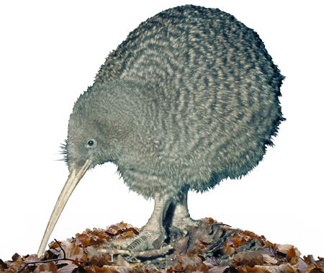
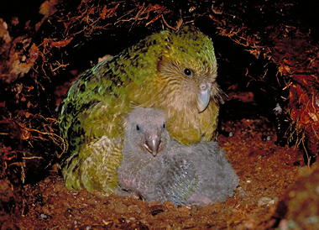
New Zealand’s Biodiversity
New Zealand has a unique biota: a result of its long isolation
from continental land masses and its unique
geological history.
Tuatara
NZ sealion
Kauri snail
Kakapo
Tree ferns
Great spotted kiwi

Slide 5
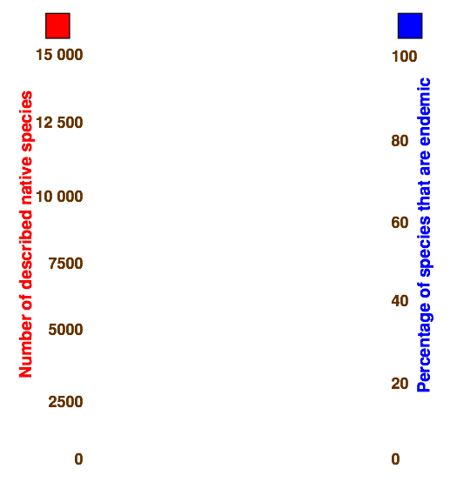
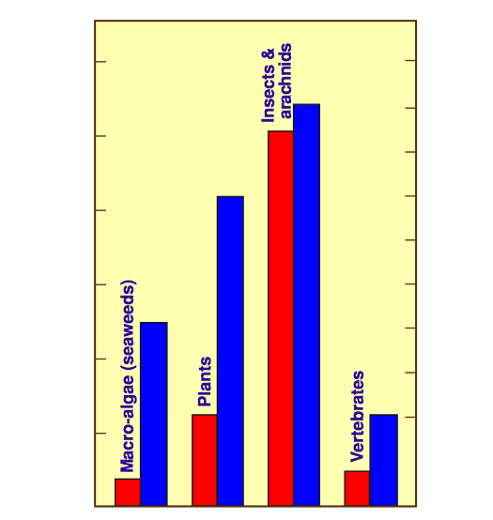
NZ’s Endemic Species
New Zealand has a high percentage of endemic species (species found nowhere else in the world) and a high diversity within certain taxa.
The column graph shows the percentage of endemic species
(right axis) for some selected taxonomic groups of New Zealand native species.

Slide 6
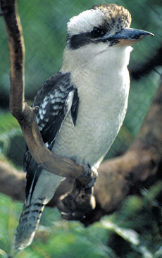
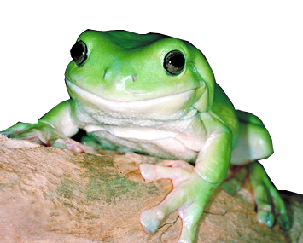
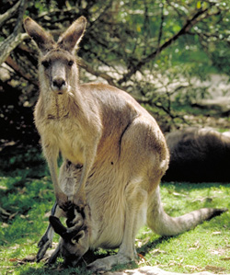
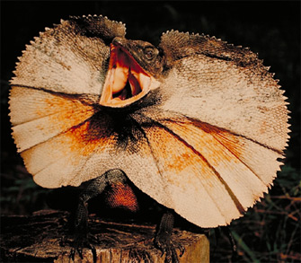
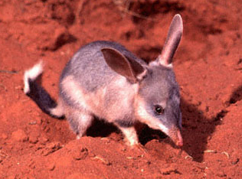
Australia’s Biodiversity
Australia’s biodiversity is unique. It is one of six floristic regions, with a characteristic flora dominated by eucalyts and acacias.
It has two of the three living
monotreme species, and the
largest proportion of the
living marsupials.
Kookaburra
Green tree frog
Kangaroo
Frll necked lizard
Bilby

Slide 7
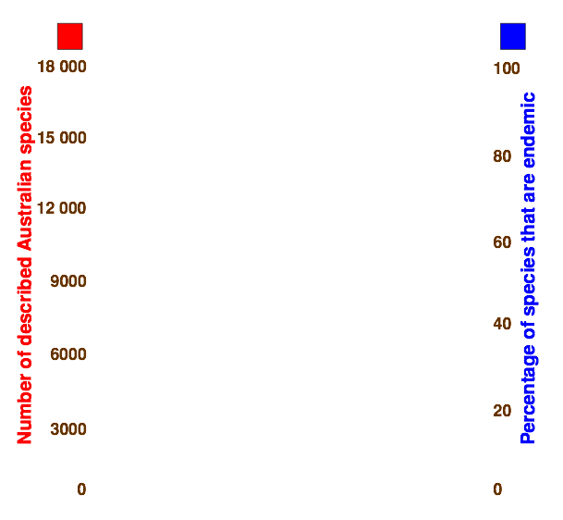
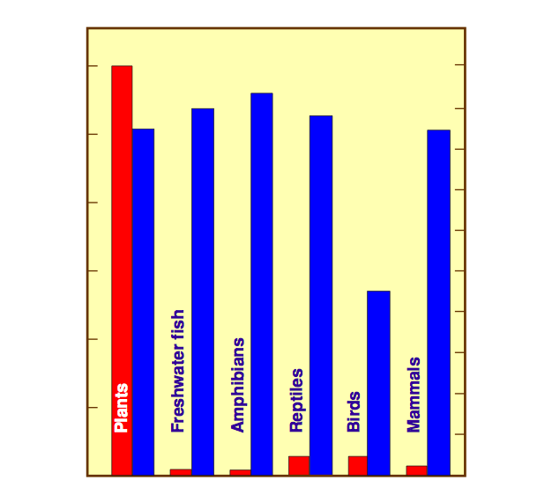
Australia’s Endemic Species
The bar graph illustrates the percentage of endemism among Australian species (right axis) for flowering plants and some selected vertebrate taxa.
The percentage endemism very high in all cases except for birds.

Slide 8
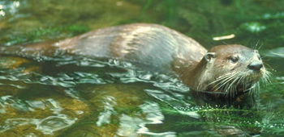
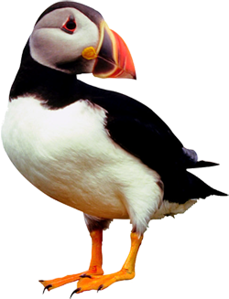
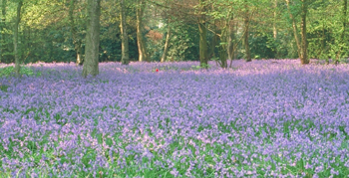
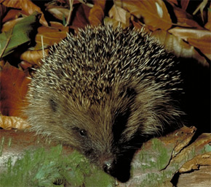
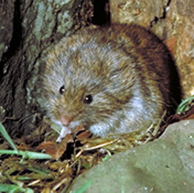
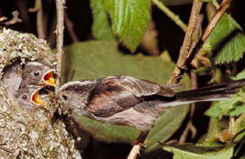
Britain’s Biodiversity
Many of the species characteristic of Britain’s biodiversity are also found more widely in Europe.
Other species, e.g. the Scottish
crossbill, or species associations,
for example, bluebell woodlands,
are uniquely British.
Otter
Puffin
Bluebells
Hedgehog
Field vole
Long tailed tit

Slide 9
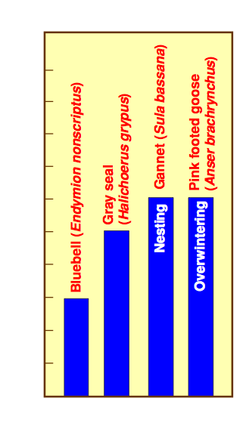
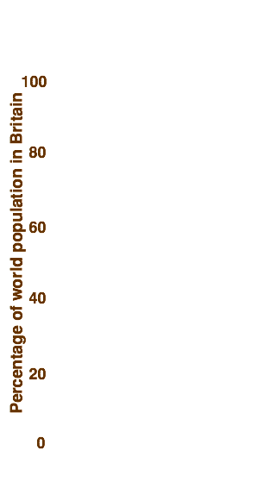
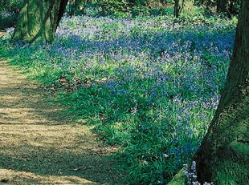
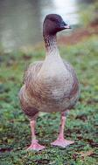
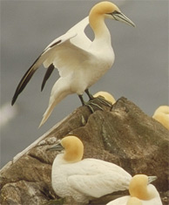
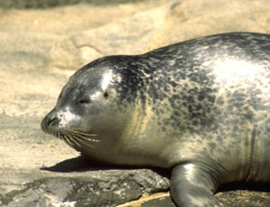
Britain’s Residents
The bar graph illustrates the percentage of world populations of various species permanently or temporarily resident in Britain.

Slide 10
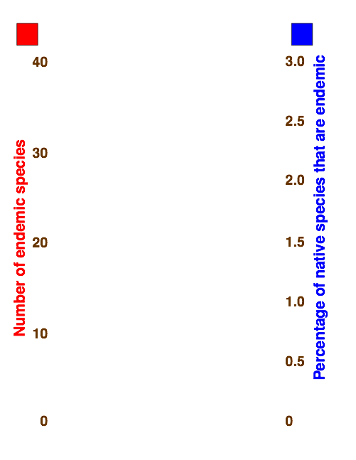
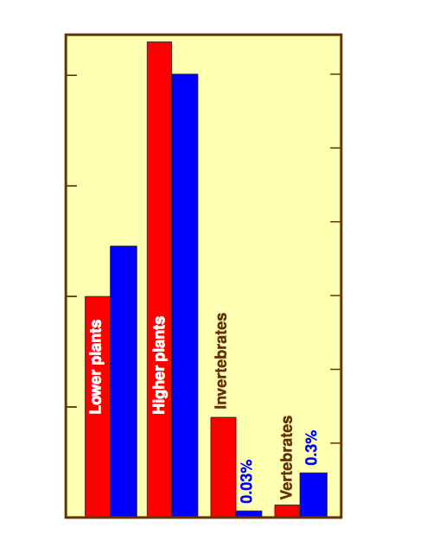
Britain’s Endemic Species
The bar graph illustrates the degree of endemism in Britain.
The right axis indicates the percentage endemism in relation to the number of described British native species.
Percentage endemism is very low in all cases, particularly in animal taxa.

Slide 11
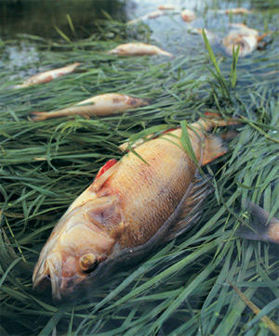
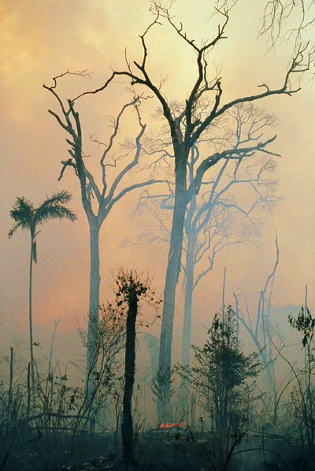
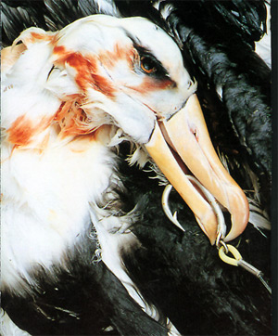
Causes of Species Decline 1
There may be many causes contributing to a species decline:
Fish kill following sewage pollution: UK
Albatross: by-catch of long- line fishing, New Zealand
Photo: Jane Ussher
Rainforest destruction: Amazon basin
Pollution by toxic substances which directly or indirectly cause harm.
Non-target species form the by-catch of commercial hunting and fishing operations.
Habitat destruction as a result of changing agricultural practices and urban growth.

Slide 12
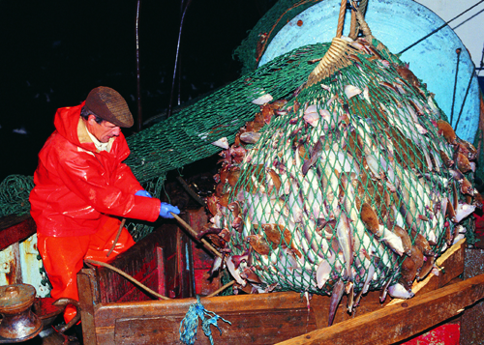
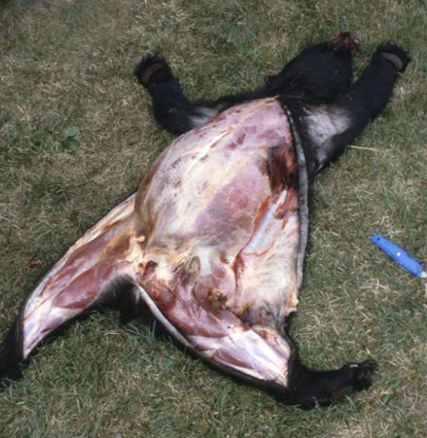
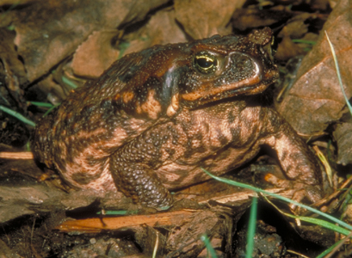
Causes of Species Decline 2
Commercial overharvesting (hunting, fishing) reduces populations to critically low levels.
Overharvesting
Poaching
Cane toads: Australia
Introduced exotic species may out- compete or prey on native species.
Sport hunting, poaching, and specimen collecting.

Slide 13
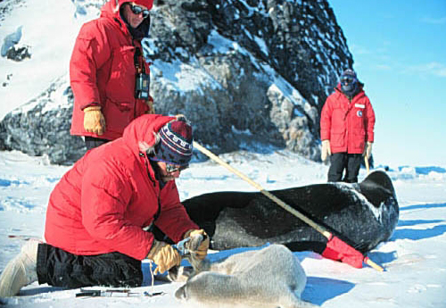
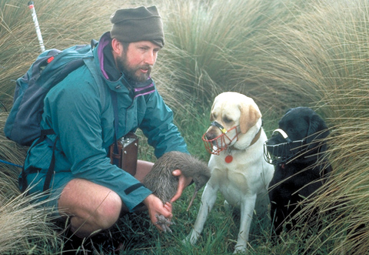
Quantifying Threat
Threatened species can be classified according to information made available from studies in the wild.
The ideal research project collects
data related to specified criteria such
as extent of geographical range and
population size. Meeting any one of
these criteria qualifies a species for
listing at that level of threat.
Tagging Weddell seals
Radiotagging green turtle
Dogs trained to locate kiwi

Slide 14
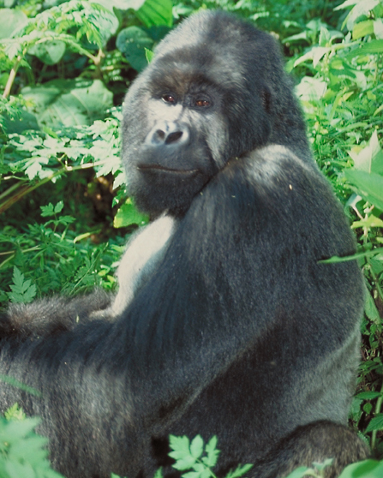
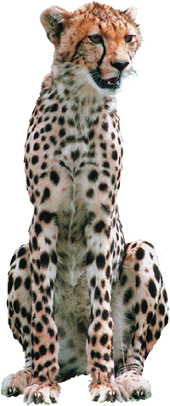
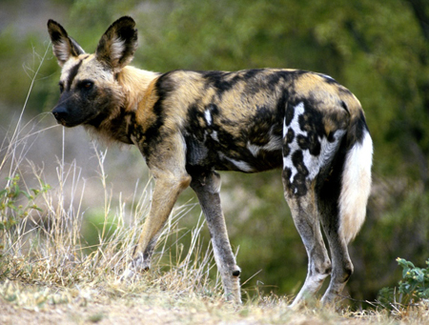

Criteria for Risk
Some of the criteria used to classify a species as at risk include:
  A substantial rate of decline (observed, inferred, or projected).
  A small geographical range that is
  shrinking or is projected to shrink.
  A small population that is either
  single, or fragmented into isolated
  subpopulations.
  A strong probability of extinction
  within a specified time period, revealed by a quantitative analysis of population viability.
Eastern lowland gorilla:
<5000 restricted to Zaïre
Cheetah: Inbred. Extinct in much of their former range. Their current range is fragmented.
African wild dog:
Africa’s most threatened carnivore

Slide 15
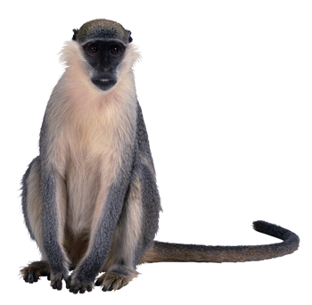
Criteria for Threatened Species
Population trait | Vulnerable | Endangered | Critical
Observed decline | 20% in 10 yrs or 3 generations | 50% in 10 yrs or 3 generations | 80% in 10 yrs or 3 generations
Geographical range | < 20 000 km² < 10 locations | < 5000 km² < 5 locations | < 100 km² single location
Total population N = population size Ns = subpopulation sizes | N < 10 000 Ns < 1000 | N < 2500 Ns < 250 | N < 250 Ns < 50
Projected decline | > 20% in 10 yrs or 3 generations | > 20% in 5 yrs or 2 generations | > 25% in 3 yrs or 1 generation
Probability of extinction | > 10% in 100 yrs | > 20% in 20 yrs or 5 generations | > 50% in 10 yrs or 3 generations

Slide 16
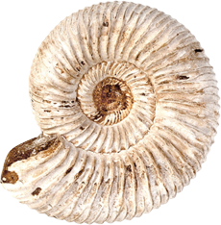
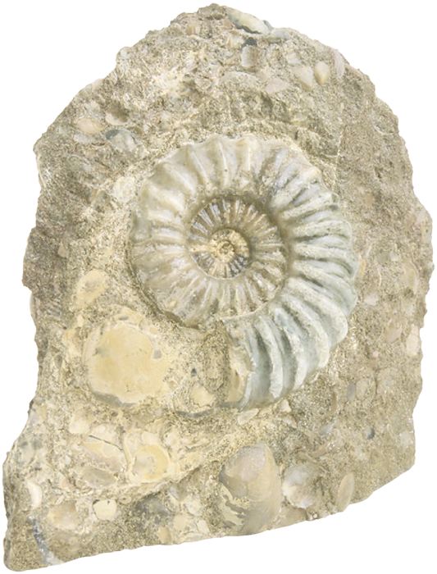



Extinctions 1
Extinction is a natural process that is part of the life cycle of a species.
  The background extinction rate is the rate of species turnover in a taxonomic group.
  The duration of a species can range
  from as little as 1 million years for
  complex organisms, to as long as
  10-20 million years for simpler organisms.
  Superimposed on the background extinction rate are catastrophic events that wipe out large numbers of
  species in relatively brief periods
  of time. There have been five
  of these in the past.
Ammonite
Diatryma
Woolly mammoth
Trilobites

Slide 17


Extinctions 2
There has been a rapid increase in extinction rates as a result of human activity. Scientists estimate that human destruction of natural habitat is driving up to 100 000 species to extinction every year.
This recent acceleration in species loss is sometimes called the sixth extinction.

Slide 18



Species Management 1
Various management strategies are used to protect species at risk and help threatened species to return to sustainable population sizes.
These management strategies are used worldwide and include:
Programs of captive breeding, followed by relocation and population monitoring, e.g. kokako relocation, New Zealand
Habitat restoration and protected areas, e.g. predator proof fence, New Zealand
Zoos, botanical gardens, and gene banks of seed and sperm collections, e.g. captive reared Okapi.

Slide 19




Species Management 2
Public education and the work of international conservation agencies like the World Conservation Union (ICUN).
Establishment of nature parks and reserves, e.g. Everglades National Park, Florida
Legislative bans on trade in endangered species (CITES)
Corporate sponsorship, e.g. kakapo recovery sponsored by Comalco

Slide 20



Primates at Risk
According to the threatened species criteria used to create the International Union for Conservation of Nature (IUCN) Red List, one out of every three of the world’s 200 primate species is threatened with extinction, and one in seven is so endangered that it could be extinct within decades.
  12% are at critical risk of extinction
  12% are endangered
  14% are deemed vulnerable
Unfortunately, categorizing these species as endangered has done little to reduce their decline.
Chimpanzees: Africa
Lemur: Madagascar
Owl monkeys: South America

Slide 21



African Elephant Conservation
Both African and Asian elephant species are under threat of extinction.
  The IUCN has rated the Asian
  elephant as endangered and the
  African elephant as vulnerable.
  In Africa, elephant numbers
  declined from 1.3 to 0.6 million
  during the 1980s. A census in
  1998 estimated fewer than
  0.5 million in existence.
Location of the African elephant

Slide 22


The Ivory Trade
From 1975 to 1989 the ivory trade was regulated under CITES (the Convention on International Trade in Endangered Species of Wild Fauna and Flora), and permits were required for international trading.
Frm 1960 onwards, figures for African exports are unreliable because of political unrest.
1975: CITES intervention to regulate trade in ivory
1989: Worldwide ban on trade in ivory
2002: Sale of stockpiled ivory by Botswana, South Africa, and Namibia approved by CITES

Slide 23

Confiscated Ivory
In response to the 1989 world wide ban on trade in ivory, the Kenyan government publicly burnt 12 tonnes of confiscated ivory. With the increased awareness of the issue, the USA and several European countries banned ivory imports.
In 2002 the sale of legally stockpiled ivory to Japan was approved by CITES. There is still great concern that such a move may trigger a reemergence of the fashion for ivory goods and fuel illegal trade.
Wardens weighing confiscated ivory

Slide 24



Rhinoceros Horn
Black rhinoceros (Diceros bicornis) (right) were once plentiful throughout sub-Saharan, southern, and eastern Africa.
  Remnant populations are now only found
  in Kenya, Tanzania, the Central Republic,
  and Zimbabwe.
  Kenya has lost 98% of its black rhino population in 17 years.
Dehorning programs (centre right) may not halt the slaughter; dehorned rhinos are still shot, probably to reduce rhino populations and increase the value of stockpiled horn (lower right).

Slide 25


Conservation of the Barn Owl
The barn owl (Tyto alba) is one of the best known and widely distributed owl species in the world. It was once very common in Britain, but has declined severely as a result of the impacts of habitat loss, changed farming practices, and increased sources of mortality.
  Conservation measures have stabilized
  numbers, but a return to the population
  of 50 years ago is highly unlikely.
Barn owls are widely distributed in the UK and Ireland, but numbers are not high.
Barn owl: Tyto alba

Slide 26

UK National Conservation
The conservation problems faced by the United Kingdom are typical of many other developed nations:
  loss of biodiversity
  loss of natural habitat
  pollution
  waste disposal
  inadequate recycling
  land use conflicts
  urban sprawl
  high energy consumption

Slide 27





UK Conservation Agencies
The main conservation agencies in the UK are:
  English Nature (in England)
  Scottish Nature Heritage (Scotland)
  The Countryside Council for Wales
These agencies are responsible for the management and conservation of the UK’s biodiversity and its natural features.
They work cooperatively with governmental and non-governmental organisations to promote conservation.

Slide 28




UK National Parks
England and Wales have a number of National Parks of varying size. Correspondingly, Scotland has Regional Parks and Northern Ireland has Areas of Outstanding Beauty.
Legislation permits some forestry, farming, and quarrying within these parks.
Environmentally Sensitive Areas (ESAs) are areas whose environmental significance is a result of particular (now restricted) farming practices.

Slide 29


The Habitats Directive
In 1992, the Council of the European Communities adopted the Habitats Directive to provide a framework for the conservation of natural habitats and wild flora and fauna.
Its global objective is “to contribute towards ensuring biodiversity through the conservation of natural habitats and of wild fauna and flora in the European territory of the Member States to which the treaty applies”.
Preventing set net by-catch
Recovery of birds affected by oil spills

Slide 30


Natura 2000
Natura 2000 is an ecological network of special areas of conservation within the Habitats Directive.
Natura 2000 areas aim to conserve natural habitats and rare, endangered, or vulnerable species of plants and animals in the European Community. The types of areas included are:
  Special Areas of
  Conservation (SAC)
  Special Protection
  Areas (SPAs).
Areas of great importance
on land and sea may be
both SAC and SPA sites.
High value habitats: woodlands, lakes, and rivers

Slide 31


NZ’s Conservation Estate
In New Zealand (NZ), the Department of Conservation (DoC) is charged with the management of the country’s flora and fauna.
DoC administers 14
National Parks, 19 Forest
Parks, 4000 reserve lands and NZ’s marine protected areas.
Other non-governmental organizations (NGOs), such as Forest & Bird and the Native Forest Restoration Trust, play an important role in supporting DoC.
Nelson Lakes National Park
Milford Sound, Fiordland National Park

Slide 32



NZ National Parks
DoC plays a pivotal role in the management of New Zealand’s native ecosystems, administering all fourteen National Parks and developing recovery plans for
New Zealand’s threatened species.
About a third of New Zealand is protected
in parks and reserves.
Great spotted kiwi
Mount Cook NP

Slide 33


NZ’s Offshore
Island Reserves
New Zealand has 330 offshore islands
of 5 or more hectares.
Many are now fully protected sanctuaries
for threatened species, some of which
have been island transfers following
predator eradication programs.
Others allow limited public access.
Stewart Island

Slide 34


NZ’s Mainland Islands
Small mainland reserves can be intensively managed for a limited time with the aim of whole ecosystem recovery, although species recovery, e.g. of kaka, kokako, or kiwi, is usually an important consideration.
These restoration areas are termed mainland islands. They offer a way to meet specific conservation goals while still allowing
scope for the development
of the tourist industry.
Trounson Kauri Forest Restoration
Kuaotunu Kiwi Sanctuary
Maungatautari
Otamatuna
Mapara
Boundary Stream
Paengaroa
Karori Reservoir
Rotoiti Nature Recovery Project
Hurunui Beech Forest Restoration
Kaka benefit from forest restorations

Slide 35



European Settlement in NZ
Maori followed by European settlement altered habitat and land use in New Zealand, and changed the state of its biodiversity forever. Depletion of the biota included the extinction of:
  43 species of land birds
  more than one fifth of
  endemic seabirds
  one species of native bat
  one fish species
  three native frog species
  an unknown number of
  invertebrates and plants.
Much of NZ’s original forest has been cleared for agriculture
Archey’s frog and kakapo are among NZ’s critically endangered species

Slide 36


NZ’s Species Decline
Harvesting by early Maori contributed to the extinction of many endemic bird species and the depletion of several coastal marine mammals. This pressure intensified with European settlement.
Habitat loss and the activities of introduced pests continue to contribute to the demise of endemic species.
Vertebrate pests degrade habitat, and prey on, or compete with, vulnerable native species.
“Wood rose” is prized by collectors
Weasel with stolen egg

Slide 37



Introduced Predators in NZ
Brushtail possum
Brushtail possum
Although NZ’s native fauna are legally protected, they are still vulnerable to the many introduced vertebrate predators.
Cats prey on birds and their eggs as well as lizards, frogs, and invertebrates. A domestic cat was solely responsible for the extinction of the Stephen’s island wren population in the late 1800s.
Mustelids (stoats, ferrets, and weasels) are voracious and persistent predators of native fauna. Stoats in particular have decimated populations of species such as kiwi and kokako.
Dogs can devastate populations of ground nesting species such as kiwi. This North Island brown kiwi was killed by a dog attack.

Slide 38



Omnivorous Pests in NZ
Brushtail possum
Brushtail possum
Introduced omnivores are particularly troublesome because they will eat almost anything and will invade a wide range of habitats.
Brushtail possums, from Australia, collectively consume more than 20 000 tonnes of vegetation each night. The are choosy feeders, selecting the young foliage from favoured species, and prey on birds eggs and chicks.
Pigs are voracious feeders and eat birds, invertebrates (especially snails), and destroy habitat with their rooting activities.
Rodents, particularly black rats (above) pose a huge threat to wildlife. They eat eggs, chicks, and lizards, and compete with birds for food.

Slide 39




Grazers and Browsers in NZ
Grazers and browsers consume and trample vegetation, contribute to soil degradation, and promote the spread of invasive plant pests.
Goats (left) are more destructive browsers than deer. They have wider food preferences and are more widespread.
Among the grazing animals, sheep, through their numbers have had the greatest effect on forest and tussock ecosystems, while cattle have had the greatest effect on wetland areas.
Rabbits are a serious problem in many areas. Their activities contribute to overgrazing, soil degradation, and spread of invasive weeds.

Slide 40



Plant Pests in NZ
Both legal and voluntary measures have been adopted to combat invasions from pest plants.
Pest plants (weeds) spread rapidly, smothering natives and preventing regeneration.
Weeds include:
• Pampas grass
• Scotch thistle
• Morning glory
Other abundant invaders include trees such as willow, various pine species, and privet, as well as a large number of aquatic weeds.

Slide 41

Tuatara Status
Tuatara (Sphenodon spp.) survive only on about 30 offshore islands. The small size of islands puts them at risk and at least nine populations have become extinct this century.
Survival is threatened when rats
are present.
  The tuatara (Sphenodon guntheri) is the most threatened species. It is only present on North Brother Island.
  Sphenodon punctatus is less threatened. It is more widespread
  and numerous than S. guntheri.
Sphenodon punctatus
Sphenodon guntherii

Slide 42


Tuatara Recovery Plan
The recovery plan includes:
  increasing the security of present habitats
  captive breeding of adults and eggs of the Brother’s tuatara, eradication of kiore from island habitats
  the establishment of tuatara (both species) on new islands
  the establishment of long-term, self-sustaining captive stocks
Tuatara with transmitter

Slide 43



NI Brown Kiwi Status
The North Island brown kiwi (Apteryx australis mantelli) has the highest ranking in terms of conservation priority.
  Only 31 000 birds remain, declining by about 6% per year. Still fairly widespread in central and northern regions but threatened by habitat loss and introduced predators.
  Experimental control of predators at several ‘mainland islands’,
  e.g. Kuaotunu in the Coromandel, is currently being carried out by the Kiwi Recovery Program.
Kuaotunu

Slide 44
NI Brown Kiwi Recovery Plan
The Kiwi Recovery Program (for all kiwi species including the NI brown) was launched in 1991 by DoC in partnership with the BNZ and Forest & Bird. The program aims to ensure kiwi are safeguarded on the mainland.
Facets of the program include:
  population monitoring to
  determine population size
  and distribution
  encouraging landowner
  protection of kiwi habitat
  experimental control of
  predators
Captive breeding programs involve incubating eggs
and rearing chicks for release back into the wild.

Slide 45

NZ Sealion Status
Hooker’s (New Zealand) sealion (Phocarctos hookeri) is NZ’s only endemic pinniped, with breeding colonies on the sub-Antarctic Is.
  About 14 000 animals remain and they are classed as vulnerable but could move to endangered if current pressures on the population continue.
  Although fully protected, they are threatened through deliberate harassment and shooting, and incidental drowning associated with following squid trawl boats.
Stewart Is.
Snares Islands
Auckland Islands
95% of breeding
Campbell
Islands
Phocarctos hookeri

Slide 46

NZ Sealion Recovery Plan
The plan involves determining population size and status (e.g. age structure, pup survival) and assessing threats to the population.
The plan places a high priority on research to obtain the ecological information (e.g. on feeding) necessary to manage the species.
The species will also be known as the NZ sealion and efforts will be made to increase public awareness of its status and threats to its survival.

Slide 47

Flax Snail Status
Three Kings: P. bollonsi
Flax snails (Placostylus spp.) comprise three species (P. bollonsi, P. ambagiosus, and P. hongii), and 14 sub-species endemic to NZ.
  They are among NZ’s most endangered invertebrates, found only on a few offshore islands and in the far north.
  Mainland populations are at risk from habitat loss, and predation by pigs, rats and introduced birds.
P. ambagiosus
P. hongii

Slide 48

Flax Snail Recovery Plan
Relocation of P. ambagiosus in the 1980s had little success with only one island transfer establishing a population. Relocations in the 1990s have concentrated on moving individuals to new habitat on the mainland to increase their range.
Captive breeding programs at Massey University have had
limited success with poor survival after return to the wild.
Research continues on their management needs.
The recovery plan consists
mainly of:
  poisoning rodents
  control of pigs and stock
  enhancement of habitat
  fencing off of valuable colonies

Slide 49

Wood Rose Status
Dactylanthus taylorii
The wood rose (Dactylanthus taylorii) is rated category A.
  The wood rose is an endemic parasitic plant threatened with extinction, and it is estimated that only a few thousand plants now exist.
  Its decline is attributed to habitat destruction, collection of the sculpture-like “wood rose” which destroys the living plant, browsing and damage by possums, deer, rats and pigs.

Slide 50
Wood Rose Recovery Plan
This primarily involves protection of plants on DoC lands from browsing and other damage. Methods include possum control and fencing to exclude trampling stock, rats, pigs and collectors.
Hand pollination of plants is
planned in situations where fine
mesh exclosures are used.
Other objectives include the
promotion of public awareness
of the plant and its placement in
the CITES endangered species
list so that the collection of the
wood rose and its export and
sale to tourists becomes a
punishable offense.

Slide 51

Takahe Status
Distribution of takahe
The takahe (Porphyrio mantelli)
was thought to be extinct until its rediscovery in 1948, after which a 500 km² area within Fiordland National Park was set aside for its conservation.
  A 1999 census revealed that
  there are around 214 takahe,
  of which an estimated 124 are living wild in the Murchison Mountains in Fiordland.
  Approximately 90 birds are
  now established in captivity or on offshore islands.
Recent distribution before 1948
Present distribution
Birds held for release
Birds held in captivity
Murchison Mountains

Slide 52

Takahe Recovery Plan
Takahe recovery in the wild relies on ongoing intensive pest control, especially of red deer, which browse takahe tussock food sources.
The long-term goals include:
  ensuring that the Murchison
  Mountain population remains
  stable or increases
  expanding the total Fiordland
  population through the
  introduction of captive bred birds
  maintaining at least three
  populations on offshore islands
  and in captivity

Slide 53

NI Kokako Status
The North Island Kokako
(Callaeas cinerea wilsoni) is rated
category B. There are fewer than 1400
birds surviving in restricted locations (right).
It is the only member of its family
surviving on mainland NZ.
  Its relatives include the extinct huia, the South
  Island kokako (assumed extinct) and saddlebacks
  (now restricted to offshore islands).
Mapara was chosen by DoC as a
mainland island management program
because it was large enough to sustain
a viable population of kokako, yet
small enough to effectively implement
long term pest control.
Trounson Park
Little Barrier
Te Urewera National Park
Pureora
Kapiti
Mapara

Slide 54

NI Kokako Recovery Plan
The first of its kind, the kokako recovery plan was implemented at Mapara by the Department of Conservation in 1991, in association with State Insurance and Norwich Union as sponsors.
  The Mapara Recovery Program used a whole ecosystem management approach involving population monitoring and intensive pest control programs.
  The numbers of birds are increasing at Mapara (the population doubled in seven years). Pest control was withdrawn in 2000.
Release of banded kokako at Mapara
Mapara kokako chick (4 weeks)

Slide 55

Kakapo Status
Te Hoiere (Maud Is.)
The kakapo (Strigops habroptilus)
is listed as critically endangered.
There are only 86 known birds
surviving and it is DoC’s
highest priority for recovery.
It has proved a difficult species
to manage. Recovery, while
feasible, will be slow.
  It is not closely related to other
  parrots, breeds only every
  four years or so, and is very
  vulnerable to mammalian
  predators and habitat loss.
Past and present kakapo distribution
Fiordland (past range); believed extinct since 1987
Te Kakahu (Chalky Is.)
Stewart Is. (past range); population relocated 1980-1997
Whenua Hou (Codfish Is.)

Slide 56


Kakapo Recovery Plan
The National Kakapo Team and DoC continually revise the recovery plan, which covers the ongoing management of kakapo.
  The goals for kakapo recovery include:
    Maximizing egg and chick survival
    by monitoring nests and reducing
    sources of mortality (e.g. rat and
    stoat control).
    Maintaining and increasing the
    breeding life of the birds and
    increasing their breeding frequency.
    Managing islands for kakapo and
    establishing stable, self-sustaining
    island populations.

Slide 57

Managing Australian Endangered Species
Endangered species management in Australia is coordinated through two major Commonwealth programs: the Endangered Species Program and the Feral Pests Program.
  These programs aim to prevent further extinctions and restore endangered species to a secure position in the wild.
Non-governmental conservation
organizations in each state play
an important role in supporting
the conservation effort and
lobbying for legal protection of
endangered species.
Dainty green tree frog

Slide 58

Kowari Status
The kowari (Dasycercus byrnei) is classified as vulnerable.
It is now confined to the Lake Eyre Basin where it occupies Mitchell grasslands. It is locally extinct in many areas of its former range.
Reasons for its decline are difficult to assess although introduced predators, cattle grazing and increased vehicular traffic have all been implicated.
Distribution of kowari
Lake Eyre Basin outside the Simpson desert bioregion. Recent reports suggest a distribution to the east of the Simpson Desert in Queensland.

Slide 59

Kowari Action Plan
The plan aims to establish and implement a long-term monitoring program at selected sites throughout their range. Existing populations of kowari will be studied with a view to better protection and management.
  Emphasis has been placed
  on examining the impact of
  cattle grazing and developing
  habitat models as suitable
  habitat richness appears
  important to kowari success.
  Further actions will depend
  on the outcomes of current
  research.

Slide 60

Greater Bilby Status
The greater bilby (Macrotis lagotis) is classified as vulnerable.
It formerly occupied over 70% of mainland Australia but populations have declined up to 90% since European settlement.
Threats are related to competition and predation from foxes and cats, habitat destruction from introduced herbivores, and the absence of a suitable fire regime for maintaining their spinifex habitat.
Distribution of the greater bilby
Wild bilby populations are restricted mainly to the Tanami Desert, Great Sandy and Gibson Deserts, and a small region in SW Queensland.

Slide 61


Greater Bilby Action Plan
The distribution, census and habitat use of the greater bilby have been determined and aims are to move the species from vulnerable to lower risk in the next decade. It will be protected in its current range (e.g. through predator control), and reintroduced into its former range (SA, NSW, and WA).
  Procedures for captive breeding and reintroducing captive-bred animals have been established.

Slide 62

Spotted-Tail Quoll Status
The spotted-tail quoll (Dasyurus maculatus maculatus) is classified as vulnerable.
It has undergone a major contraction of its former range and distributions are patchy.
Reasons for its decline relate to predation by foxes and dogs, habitat loss, direct persecution because they kill caged birds, and non-target killing on the roads and as a result of poisoning operations.
Distribution of spotted-tail quoll
Now very rare in SE Queensland. The most abundant populations are in north-eastern NSW. Distributions are patchy in Victoria. Widespread but rare (probably naturally) in Tasmania.

Slide 63

Spotted-Tail Quoll Action Plan
Surveys will better establish the current population distribution.
The action plan aims are:
to study the species biology
and monitor populations,
prevent further habitat loss,
minimise the impact of
poisoning by targeting pest
species more effectively,
and educating the public to
lower losses through road
kills and direct killing.

Slide 64

Green & Golden Bell Frog Status
The green and golden bell frog (Litoria aurea) is classified as endangered.
Reports are of major declines
in NSW and the ACT, although species identification is difficult. Its former distribution was much wider within NSW, eastern Victoria and the ACT.
Reasons contributing to their decline are the destruction of wetland habitat, and there is evidence of predation of eggs and tadpoles by mosquito fish.
Distribution of Litoria aurea
Now almost entirely absent from the southern highlands and the ACT. Patchy distribution along the SW coast but almost continuous in eastern Victoria.

Slide 65

Green & Golden Bell Frog
Action Plan
The plan aims to determine accurately the current status of the green and golden bell frog and to recommend actions to halt the declines.
  A management plan is in
  place to restore suitable
  habitats and relocate
  species to areas of their
  former range.
  Taronga Zoo has already
  conducted a preliminary
  captive breeding program.

Slide 66


Parks & Reserves in Australia
The Australian Government manages Commonwealth parks and reserves including areas located on external island territories and within Australian waters. Each Australian
State and Territory Government
also has their own protected
area management agencies.
  Kakadu NP, Uluru-Kata
  Tjuta NP, and Booderee
  NP are managed jointly
  with their traditional
  Aboriginal owners.
Nature Conservation Reserve (Coastal Park, Conservation Reserve, National Parks etc.)

Slide 67


Parks & Reserves in Canada
Canada’s National Parks are a country-wide system of representative natural areas of Canadian significance.
They are protected, by law,
for public understanding,
appreciation, and
enjoyment, while
being maintained
for future generations.
National parks have
existed in Canada
for well over a century.
National Parks

Slide 68


Parks & Refuges in the USA 1
Some 83 million acres (11% of public lands) of the USA are in National Parks and Preserves, which protect natural resources, while allowing restricted activities.
National wildlife refuges form a network across the USA, with at least one in every state. They provide habitat for endangered species, migratory
birds, and big game.
National Parks
Wildlife refuges

Slide 69



Parks & Refuges in the USA 2
Alaska contains more than half the total acreage of the park system. It is rich in diversity and shelters a wealth of wildlife.
Hawaii’s federal domain Haleakala National
Park, known for its immense crater
and rare plants, including the endemic
silversword. Hawaii Volcanoes
National Park has two of the world’s
most active volcanoes.
Alaska
Hawaiian Islands
National Parks
Akaka Falls, Hawaii
Wildlife refuges

Slide 70

Ecosystem Stability
An ecosystem’s stability refers to its apparently unchanging nature over time.
Components of ecosystem stability include inertia (the ability to resist disturbance) and resilience (the ability to recover from external disturbance).
The diversity of ecosystems at low latitudes (nearer the equator) is generally higher than at higher latitudes (nearer the poles). This photograph shows a forest in Hawaii.

Slide 71


Stability and Species Loss
Ecological theory suggests that all species in an ecosystem contribute to ecosystem function.
Species loss past a certain point is likely to be detrimental to the functioning of the ecosystem and on its ability to resist change (its stability).
Ecosystem stability is closely linked with biodiversity but it is not clear what level of biodiversity is required to guard against ecosystem dysfunction.
Species play different roles in ecosystems

Slide 72


Key Species
Species whose influences on ecological communities are greater than would be expected on the basis of their abundance are called key (keystone) species.
  They are more influential in ecosystem stability than other species because of their pivotal role in some ecosystem function such as nutrient cycling.
Elephants are a key species, and can alter the entire structure of the vegetation in those areas into which they migrate.
  Their pattern of grazing on taller plant species promotes a predominance of lower growing grasses with small leaves.
Elephants knock down and consume taller trees and shrubs...
… allowing lower growing species to predominate

Slide 73



Invertebrates as Key Species
Termites are key species. They are among the few larger soil organisms able to break down plant cellulose.
  They shift large quantities of soil and
  plant matter and have a profound effect
  on the rates of nutrient processing in
  tropical environments.
Pisaster ochraceous, the ochre star, is also a key species. It feeds on mussels along the coasts of North America.
  If it is removed, mussels dominate, crowding out most algal species and leading to a decrease in the number of herbivore species.
Termite hill, Australia
The ochre star, California

Slide 74


Environmental Change
In models of ecosystem function, higher species diversity increases the stability of ecosystem functions such as productivity and nutrient cycling.
  A low diversity system varies more consistently with environmental variation.
  A high diversity system is buffered against major fluctuations.

Slide 75


Low Diversity Systems
Monocultures (single species crops), are low species diversity systems. They are vulnerable to disease, pests, and disturbance.
In contrast, natural ecosystems
may appear homogeneous, e.g.
grasslands, but contain many
species which vary in their
predominance seasonally.
  Although natural grasslands may be
  easily disturbed, e.g. by burning,
  they are very resilient and usually
  recover quickly from disturbance.
Monoculture
Savanna

Slide 76

High Diversity Systems
The biodiversity of ecosystems at low latitudes is generally higher than that at high latitudes, where climates are harsher, niches are broader, and systems may be dependent on a small number of keystone species.
Tropical rainforests are amongst the highest diversity ecosystems on Earth. They are generally quite resistant to disturbance, but once once degraded they have little ability to recover.
Deforestation of tropical rainforest

Slide 77


Diversity Indices
One of the best ways to determine the health of an ecosystem is to measure the variety of organisms living in it.
Diversity indices attempt to quantify the degree of diversity and identify indicators for environmental stress or degradation.
Natural, unaltered headwater streams are generally high in diversity
Artificially managed and channelled rivers are generally low in diversity

Slide 78



Calculating Diversity Indices
Most indices of diversity are easy to use and widely used in ecology.
Diversity indices include Simpson’s Index for finite populations and the complement of Simpson’s Index for an infinite population (below).
  The index ranges from 0 to almost 1
High diversity stream community
pi² = Ni/N: the proportion of species i in the population
Ni = the number of individuals of each species in the sample
N = the total number of individuals of all species in the sample
Photos; Stephen Moore
Low diversity stream community

Slide 79


Slide 80
Terms of Use
Biozone International retains copyright to the intellectual property included in this presentation file, with acknowledgement that certain photos are used under license and are credited appropriately on the next screen.
You MAY:
  Use these slides for presentations in your classrooms using a data projector, interactive whiteboard, and overhead projector.
  Place these files on the school’s intranet (school computer network), but not in contradiction of clause 3 (a) below.
  Edit and customize this file by adding, deleting, and modifying information to better suit your needs.
  Place these presentation files on any computer within the school, including staff laptops.
  Print out this file in PowerPoint “Handouts” format as per the print dialogue box, for the express purpose of allowing students to make their own notes about the presentation.
You MAY NOT:
  Put these presentation files onto the internet or on a service that may be accessed offsite from the campus, unless access to the service is protected by a user login and password protocol.
  Print these files onto paper to make your own worksheets for distribution to students.
  Create a NEW document using any of the graphics/images in this presentation file.
  Incorporate any part of this presentation file for the production of another commercial product.
  REMOVE any of the references to Biozone, the copyright notices, photo credits, or terms of use from this file.

Slide 81
Photo Credits
Photographic images are used under license from the following photo libraries:
  Corel Corporation Professional Photos
  ArtToday.com
  Clipart.com
  Hemera Technologies Inc.
  PhotoObjects.com
  Other photographs contributed by Dept of Conservation (NZ) and forest & Bird (NZ)
Additional artwork and photographs are the property of Biozone International Ltd.
BIOZONE International Ltd | P.O. Box 13-034, 109 Cambridge Road, Hamilton, NEW ZEALAND
Phone: + 64 7 856-8104 | Fax: + 64 7 856-9243 | E-mail: sales@biozone.co.nz | Internet: www.biozone.co.nz
Copyright © 2005 Biozone International Ltd
All rights reserved

Slide 82







Presentation MEDIA
See our other titles:
See full details on our web site:
www.thebiozone.com/media.html

